Slide 1

END SEM PRESENTATION
on
TEXT READABILITY DETECTION FOR AI INTERVIEW BOT
Team Members
A. UDAY BHASKER BL.EN.U4AIE21005
B. RUCHITH BALAJI BL.EN.U4AIE21017
Date:22/05/24
Course :NLP
Peeta Basa Pati sir
AI 6th Sem –E Sec

Slide 2
CONTENTS
Introduction
Problem statement
Use of this project
Methodology
Results
Conclusion

Slide 3
INTRODUCTION
The primary goal is to predict the readability of text using DistilBERT, a streamlined and efficient version of the BERT model designed for natural language processing tasks.
DistilBERT offers significant improvements in speed and resource utilization compared to its predecessor, making it ideal for practical applications where performance and scalability are crucial.
The process involves key steps including text preprocessing, model loading, data encoding, and inference, culminating in the generation of readability scores or classifications.
This approach can be applied across various domains such as education, content creation, and user experience design, providing valuable insights into the readability of text and enhancing the overall quality and accessibility of written content.

Slide 4
PROBLEM STATEMENT
The problem Statement is to develop a text readability prediction for AI Interview voicebot.
The goal is to build a scalable and efficient solution that incorporates advanced techniques to detect Plagiarism
Challenges:
Data Collection.
Choosing a Model.
Maintaining Efficiency.
Handling Errors.

Slide 5
Model Diagram
Speech 2 Text
STEP-2
Text ReadabilIty Prediction
Question
Generation
Pre-Processing
STEP-1
STEP-4
STEP-5
STEP-3
Emotion
Recognition
STEP-6
Text 2 Speech

Slide 6
USE CASE
Readability prediction helps the bot adapt its responses based on the comprehension level of the user.
If the user's text is complex, the bot might simplify its responses to ensure clear communication. Conversely, if the user's text is straightforward, the bot can respond with more advanced vocabulary or concepts.
Not all users have the same reading abilities. Readability prediction helps ensure that the bot's responses are accessible to users with varying levels of literacy or language proficiency.
For interview bots used in educational settings, readability prediction can help gauge the user's comprehension level and provide appropriate learning materials or guidance tailored to their needs.

Slide 7
METHODOLOGY
In this initial step, text data is uploaded into the model.
The text data undergoes a series of transformations to prepare it for the model. This includes:
Tokenization: The text is divided into smaller units such as words or sentences.
Lowercasing: All letters in the text are converted to lower case.
Removing punctuation: Punctuation marks are eliminated from the text.
The preprocessed text data is then encoded into a format that the model can understand. This typically involves converting the text data into numerical vectors.
The encoded text data is fed into the DistilBERT model, a pre-trained transformer model. The model then analyzes the data to predict the readability of the text.

Slide 8
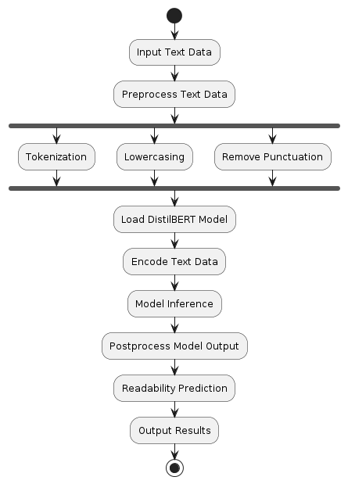
METHODOLOGY

Slide 9
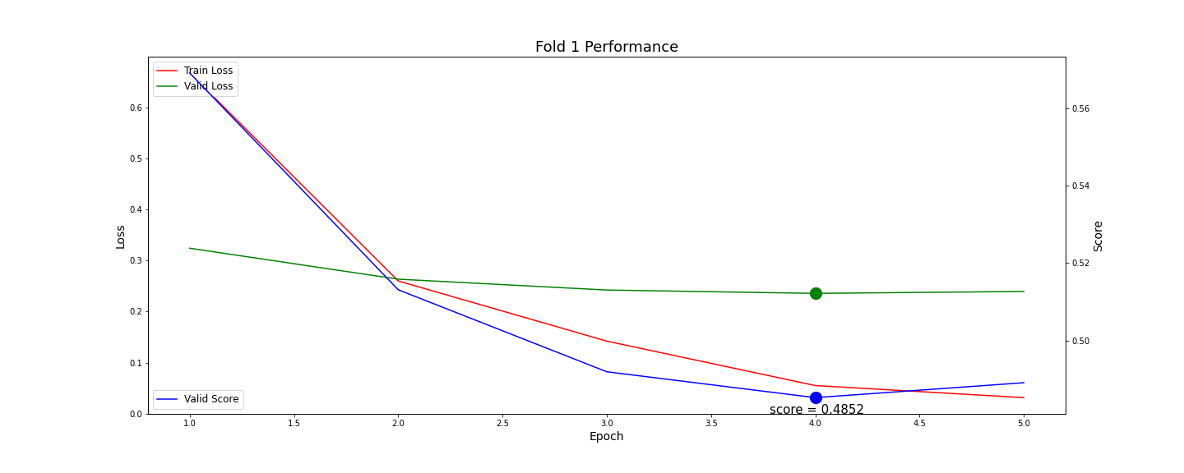
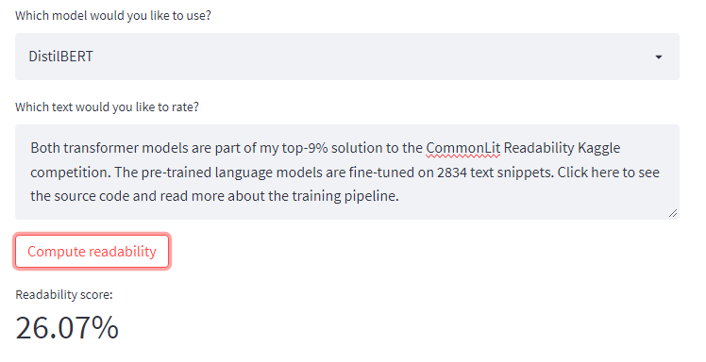
RESULTS

Slide 10
CONCLUSION
In conclusion, the methodology for text readability prediction using DistilBERT involves a structured sequence of steps, from preprocessing text data to leveraging the efficiency and performance of the DistilBERT model for inference.
By systematically tokenizing, optionally lowercasing, and removing punctuation, and then encoding the text for model processing, we can effectively utilize DistilBERT's capabilities to generate accurate readability predictions.
This approach not only enhances the efficiency of readability analysis but also ensures that the predictions are robust and practical for various applications in content creation, education, and user experience design.

